Slide 1
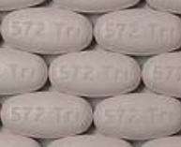
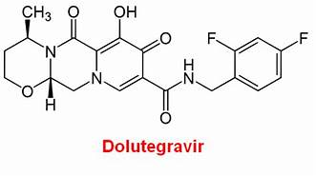
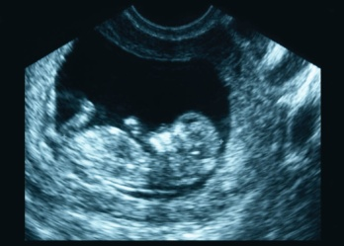
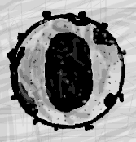


What’s New in WHO Treatment Guidelines
July 23 2018
What We Know About Safety Signals with DTG Use in Pregnancy
Lynne M. Mofenson MD
Senior HIV Technical Advisor
Elizabeth Glaser Pediatric AIDS Foundation

Slide 2

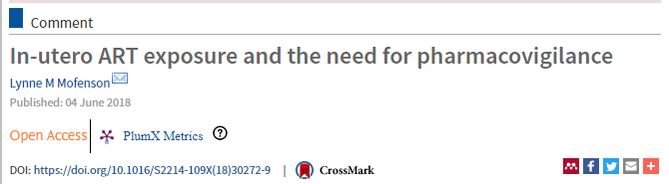

Dolutegravir
There have been only limited data on DTG in pregnancy and breastfeeding.
Unanticipated findings with preconception DTG use and neural tube defects demonstrate the importance of pharmacovigilance when new drugs are broadly introduced into the adult population.

Slide 3
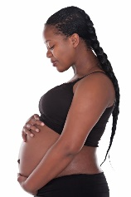
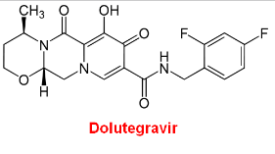
Dolutegravir and Pregnancy
Are there differences in pregnancy outcomes between ART regimens?
Discuss timing of exposure - critical and often neglected variable
DTG preclinical repro-tox and pharmacokinetic data in pregnancy and newborn
DTG and birth defects

Slide 4

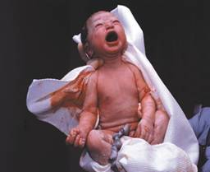

Do Pregnancy Outcomes Vary by ART Regimen?

Slide 5
Do Pregnancy Outcomes Vary By ART Regimen?
Any Adverse/Severe Adverse Outcome By Preconception ART, Botswana
Zash R et al. JAMA Pediatr. 2017;171:e172222
aRR other ART compared to EFV ART
1.15
(1.0-1.3)
1.30
(1.2-1.4)
1.31
(1.1-1.5)
1.21
(1.0-1.5)
1.44
(1.2-1.7)
1.68
(1.4-2.0)
1.58
(1.2-2.1)
1.93
(1.4-2.6)
(PTD, SGA, S, neonatal death)
(VPTD, VSGA, SB, neonatal death)

Slide 6
Regardless of ART Regimen, Pregnancy Outcomes Were Worse in HIV+ Women On ART than HIV-Uninfected Women
Zash R et al. JAMA Pediatr. 2017;171:e172222
aRR HIV-positive on ART vs HIV-uninfected
Any: 1.40
(1.3-1.4)
Severe: 1.50
(1.4-1.6)
(PTD, SGA, SB, neonatal death)
(VPTD, VSGA, SB, neonatal death)

Slide 7
Regardless of ART, Outcomes Worse than HIV-Uninfected
Any Adverse/Severe Adverse Outcome By Preconception ART, Botswana
Zash R et al. JAMA Pediatr. 2017;171:e172222
→EFV-based ART appears safer than NVP or LPV-r-based ART
→But ART - regardless of regimen - does not make pregnancy outcomes among HIV+ women the same
as in HIV-uninfected women
aRR HIV-positive on ART vs HIV-uninfected
Any: 1.40
(1.3-1.4)
Severe: 1.50
(1.4-1.6)
(PTD, SGA, SD, neonatal death)
(VPTD, VSGA, SD, neonatal death)

Slide 8

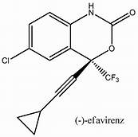
When Started During Pregnancy,
Do Pregnancy Outcomes Vary Between Women on
DTG vs EFV-Based ART Regimens?

Slide 9
When Started During Pregnancy, No Difference Pregnancy Outcomes EFV vs DTG-Based ART
Zash R et al. Lancet Global Health 2018;6:e804-10
No difference:
Major Birth Defects with
First Trimester Exposure
EFV: 1/395 (0.3%)
DTG: 0/280 (0%)
(no NTD either drug)

Slide 10
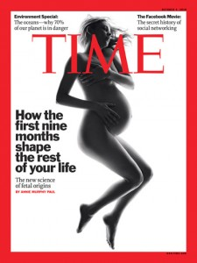
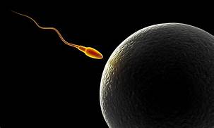
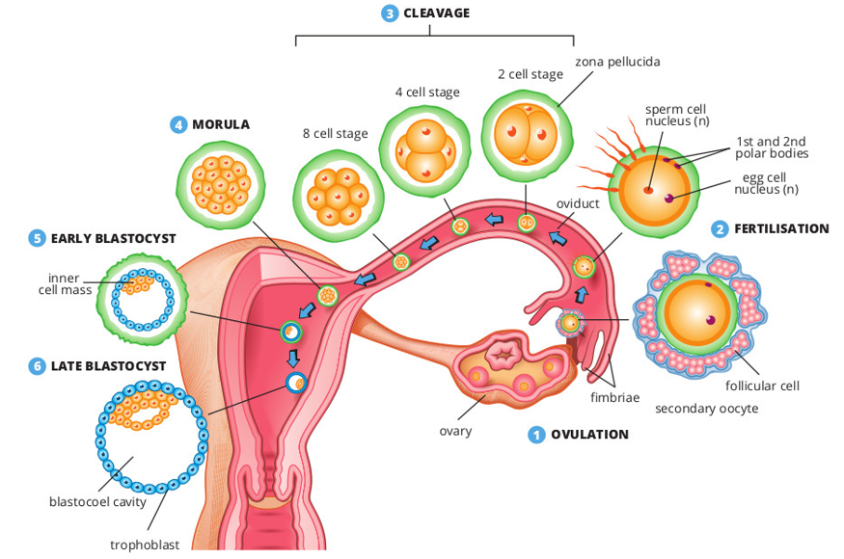
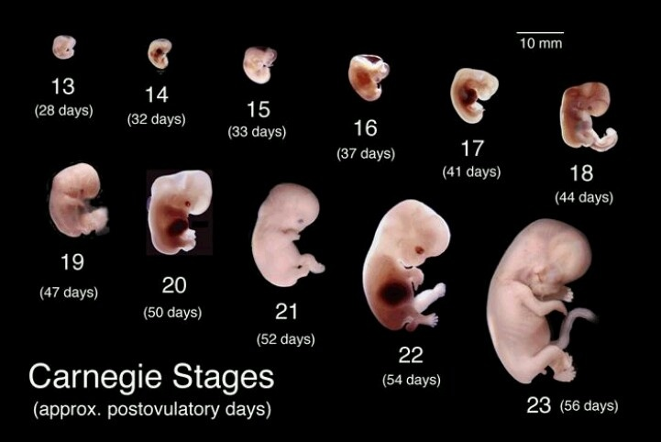
Why is Timing of ART
Exposure Important?

Slide 11
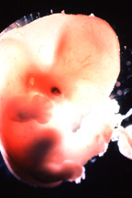
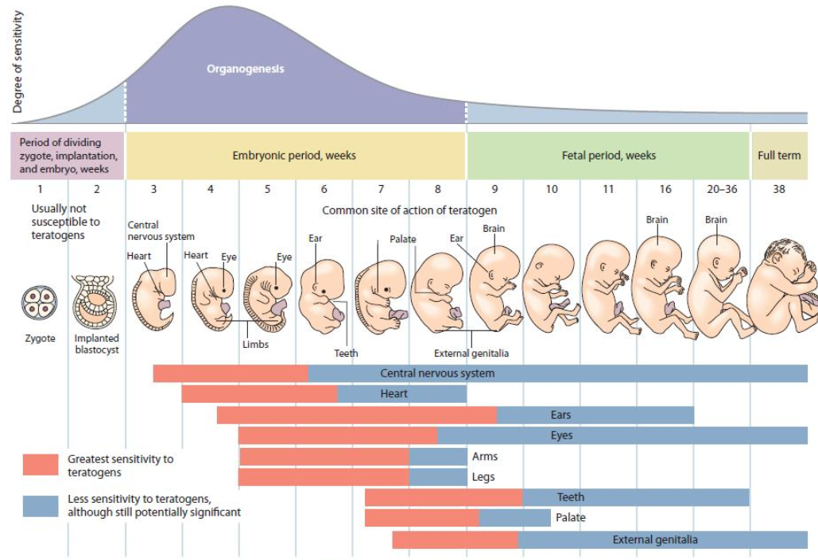
Timing of In Utero ARV Exposure
and Fetal Risk

Slide 12
Timing of In Utero ARV Exposure
and Fetal Risk
First 2.5 Weeks Post-Fertilization:
Pre-Organogenic Period
generally not sensitive to teratogens

Slide 13
Timing of In Utero ARV Exposure
and Fetal Risk
Examples:
Neural Tube Closure by
Day 28
(e.g. myelomeningocele)
Oral Structure Formation by
Day 36
(e.g. cleft palate)
Weeks 3 to 8-12 Post Fertilization
Embryogenesis: Active Organogenesis
most sensitive period to teratogens

Slide 14
Timing of In Utero ARV Exposure
and Fetal Risk
Examples:
Alcohol after 24 weeks &
fetal-alcohol syndrome
Smoking after 20 weeks
and IUGR
After 8-12 Weeks Post-Fertilization
Fetal Development Period
Fetal growth; teeth; external genitalia; continued brain develop

Slide 15
Timing of In Utero ARV Exposure
and Fetal Risk
Greatest risk for serious defects is not in women starting during pregnancy but in those who conceive while receiving drug -
but most studies do not distinguish between 1st trimester and preconception exposure

Slide 16
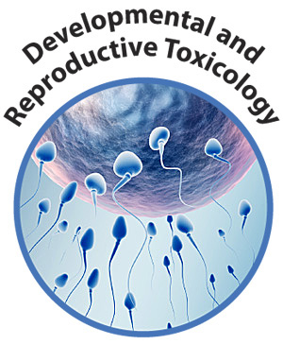

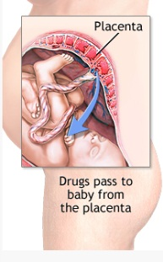
Pre-Clinical DTG Reproductive Toxicology Studies
Pharmacokinetics DTG in Pregnancy and Newborn

Slide 17

Pre-Clinical Reproductive Data on DTG
(Review of FDA and EMEA NDA Submissions)
Male and female fertility, embryofetal,and pre- and post-natal development studies in rats and rabbits at doses giving exposure up to ~27x human exposure, did not show adverse effect or evidence of teratogenicity.
While negative tests are reassuring, there is no absolute assurance that negative results obtained by testing drugs in these species can definitively predict that an agent will lack teratogenic effects in humans (Ujhazy E et al. Developmental Toxicology: Safety Evaluation of New Drugs 2005)
Similarly, it cannot be said that agents teratogenic in high doses in animals will necessarily produce teratogenic effects in humans at therapeutic dose levels (e.g., EFV and CNS defects in monkeys).

Slide 18
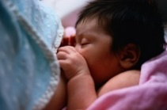
Pharmacokinetics in Pregnancy and
Placental & Breast Milk Passage
PK in pregnancy (3 studies: P1026s, 2 abstracts): Modest reduction in DTG exposure in 3rd trimester but >IC₉₀ for DTG (64 ng); standard dosing 50 mg QD okay
Placental passage (4 papers, 1 abstract with data update)
  High placental transfer of DTG (cord:maternal ratio 1.22)
  Prolonged half-life in newborn/preterm (2-3 fold higher than adult)
Breast milk (1 case report, 1 abstract with data update)
  Significant transfer DTG into milk (2-3% maternal level)

Slide 19
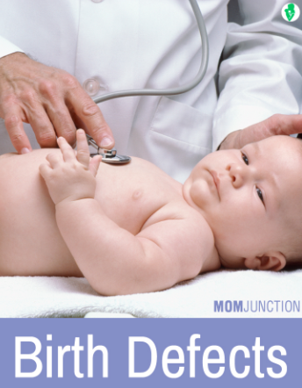
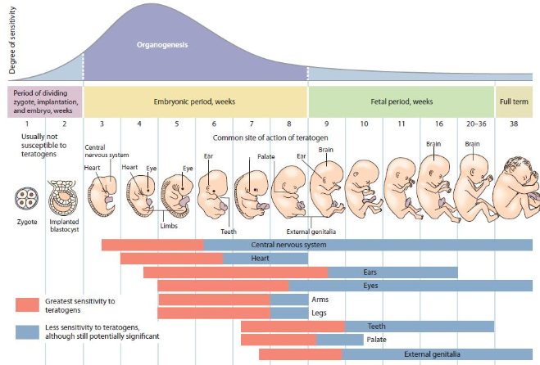
Safety
Birth Defects

Slide 20
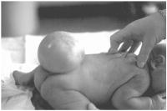
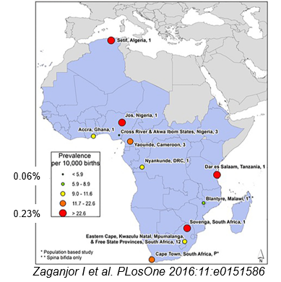
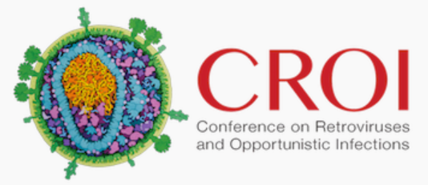
Expected Incidence of Neural Tube Defects
Blencowe H et al. Ann NY Aca Sci 2018;1414:31-46
Estimated prevalence of NTD in 2015 globally was 0.19% (0.15% to 0.23%) [19 (15–23)/10,000] birth outcomes
About 50% of cases were elective terminations or stillbirths, so evaluation of only live births gives underestimation.
African Region: Data from 11 studies from 8 countries analyzed
Median prevalence of NTD in Africa was 0.12% (range 0.06% to 0.23%)
P Musoke – CROI 2018 Abs 829
43,293 births (4,634 HIV+ women, 77% on EFV ART) in Uganda
Prevalence NTD: HIV-uninfected 0.09%, HIV+ 0.04%

Slide 21
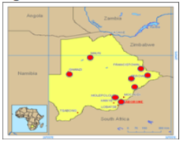
Botswana Tsepamo Birth Surveillance Study
NIH-funded study specifically designed to evaluate the risk of neural tube defects (NTD) with preconception EFV exposure.
Well-designed prospective birth outcomes surveillance for major surface birth defects, population based (45% of births in Botswana).
Good denominator with control groups and ability to distinguish between ARV regimens
  HIV-uninfected
  HIV-infected ART preconception
  HIV-infected ART started during pregnancy

Slide 22
Tsepamo Study: Neural Tube Defect (NTD)
See Rebecca Zash Late Breaker Tues July 24
Preconception DTG ART exposure: 4 NTD/426 exposures, 0.94% (95% CI 0.37%, 2.4%)
Preconception non-DTG ART exposure: 14 NTD/11,200 (0.12%, 95% CI 0.02%, 0.15%)
HIV-uninfected women: 61 NTD/66,057 (0.09%, 95% CI 0.07%, 0.12%)
Preliminary signal of significantly increased risk of NTD with preconception DTG exposure

Slide 23
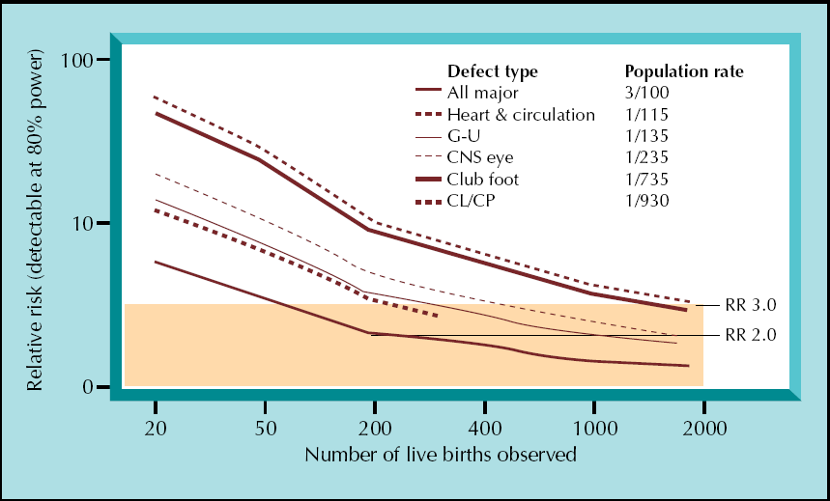
Ability to Rule-Out ↑ Birth Defect is Related to Defect Incidence and Number Observed Preconception/1st Trimester Exposures
200 exposures can rule out a 2-fold ↑ in overall birth defects (incidence 3%)
Overall defects
Incidence 3%
RR 2.0
Watts DH. Curr HIV/AIDS Rep 2007;4:135-140

Slide 24
Ability to Rule-Out ↑ Birth Defect is Related to Defect Incidence and Number Observed Preconception/1st Trimester Exposures
However, to rule-out a 3-fold increase in a relatively rare event like NTD (incidence 0.1%), need about 2,000 exposures
Neural tube defect
Incidence 0.1%
RR 3.0
Overall defects
Incidence 3%
RR 2.0
Watts DH. Curr HIV/AIDS Rep 2007;4:135-140

Slide 25
Summary Birth Defects with DTG Exposure
Studies | Overall defects | DTG Preconception | DTG 1st T | DTG 2nd/3rd T
Tsepamo study |  | 4/426 NTD, 0.94%
Studies with denominators (12 studies for any trimester, 8 for preconception exposure)
Live-births + stillbirths/ miscarriages/ terminations | 21/1010, 2.1% (72% from: Botswana 280 start during pregnancy; APR 255; NSHPC 190) | 8/352, 2.3% overall defects (84% from: APR 121; NSHPC 113; ViiV trials 61) | 4/350, 1.1% (80% from: Botswana DTG start during pregnancy) | 3/227, 1.3%
NTD |  | 0/352
Reports without denominators
ViiV post-market | 226 AE reports, 19 defects (15.5%) | 1 NTD from Namibia (no denominator for PC exp)
FDA AER database | 49 birth defect AE reports in 24 patients | 1 NTD from Namibia (no denominator for PC exp, same as ViiV case)
WHO VigiAccess | 57 AE defect reports in 47 patients, 0 NTD
Tsepamo study + prospective cases with denominators |  | 4/778 NTD, 0.51% (still higher than upper 95% CI of 0.15% non-DTG ART)
New reports since May 2018
Reports from US |  | 2 NTD (1 will be in prospective APR)

Slide 26
Summary
Data on NTD with preconception DTG are not definitive, but do represent a potential signal of concern for women of child-bearing potential.
Only 352 other preconception exposures in other studies with denominators.
Post-marketing data – with no denominator – has 3 cases of NTD with preconception DTG.
A reminder: no ART regimen is completely “safe” when compared to birth outcomes among HIV-uninfected women.

Slide 27

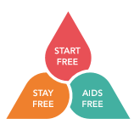
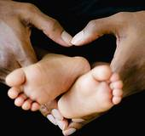

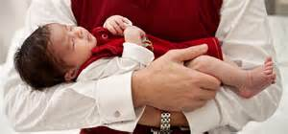
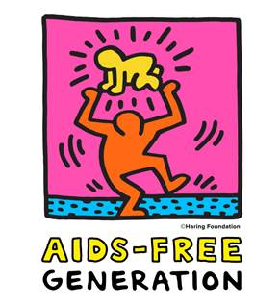

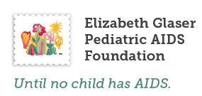
Thank you for your attention!

